Slide 1

VM live migration optimization
Ido Weinstein & Sapir Ben David
Notes:
VM = Virtual Machine

Slide 2
outline
background:
Our World
Challenges using DC.
Overcome challenges.
VM live migration.
Ways to optimize Virtual Machines live migration:
Bandwidth Optimization.
Power Consumption Optimization.
Conclusion

Slide 3
background

Slide 4


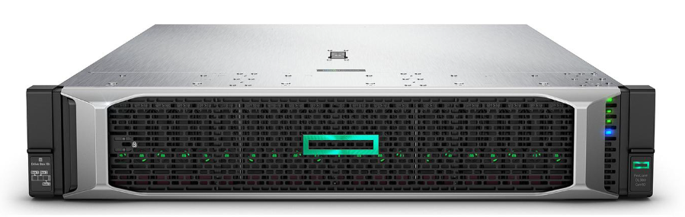
Our world
Server: physical computer or software that provides functionality for other programs or devices, called “clients”.
Data Centers: A physical site where many servers are managed. offers software and hardware services to clients based on a network connection, usually via the Internet.
Cloud Computing: refers to the delivery of on-demand computing services over the internet on a pay-as-you-go basis. (Google Drive, iCloud, Google Photos, etc.)
DCs are the heart of cloud computing.
Notes:
Server: physical computer or software that provides functionality for other programs or devices, called “clients”.
Cloud computing : Cloud computing refers to the delivery of on-demand computing services over the internet on a pay-as-you-go basis. In simple words, Cloud computing is a service that lets you use any computing service such as a server, storage, networking, databases, and intelligence, right through your browser without owning anything.
Data center (DC): A physical site where many servers are managed.
DC are the heart of modern cloud computation. offers software and hardware services to clients based on a network connection, usually via Internet.
Maintaining a DC requires a lot of resources, therefore many companies rent these services from other companies ( like Google, Microsoft, Amazon etc.)

Slide 5
Challenges using DC
Maintaining a DC requires a lot of resources and challenges e.g:
Memory management.
Isolation between clients.
Security.
Etc.
Therefore, many companies rent these services from other companies ( like Google, Microsoft, Amazon, etc.)
SLA: Service Level Agreement: an agreement between the service provider and its client, in which the nature and quality of the service that the client expects to receive are defined.
QoS: DC owner needs to meet the conditions committed to in the SLA despite the challenges.

Slide 6
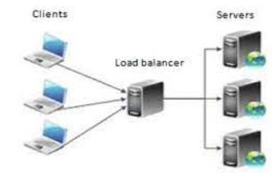
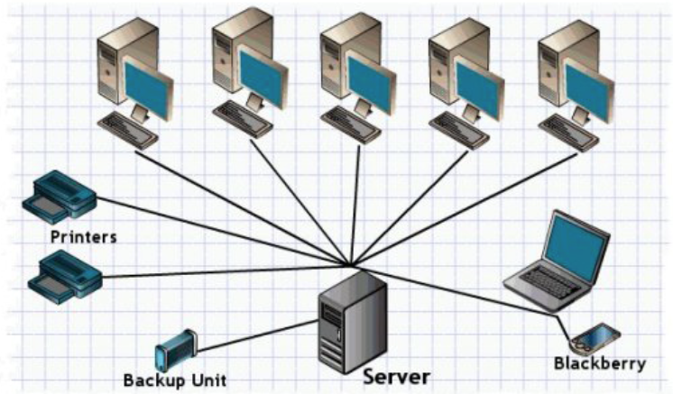
Overcome the challenges
Physical isolation of the client: assign each client a server.
Virtual Machine: each client run in a VM. VMs run on a physical server.
Overcame the serious disadvantages of physical isolation.
Allows work flexibility.
Allows to move the client’s VM between physical servers in the DC.
Moving VMs across the DC is called migration.
Advantages | Disadvantages
Optimal memory privacy. | Very expansive.
Optimal client's isolation. | Inefficient use of resources.

Slide 7
VM migration
Cold migration: The simplest VM migration.
Complete stop of the VM.
Copying the VM’s memory from source to destination server.
Restarting the VM in the destination server.
Live migration: migrate the VM without interrupting its work.
Pre-copy: copy both state and data before handover.
Post copy: first copy the CPU’s state, and then copy the data while the VM Running on the destination server.

Slide 8
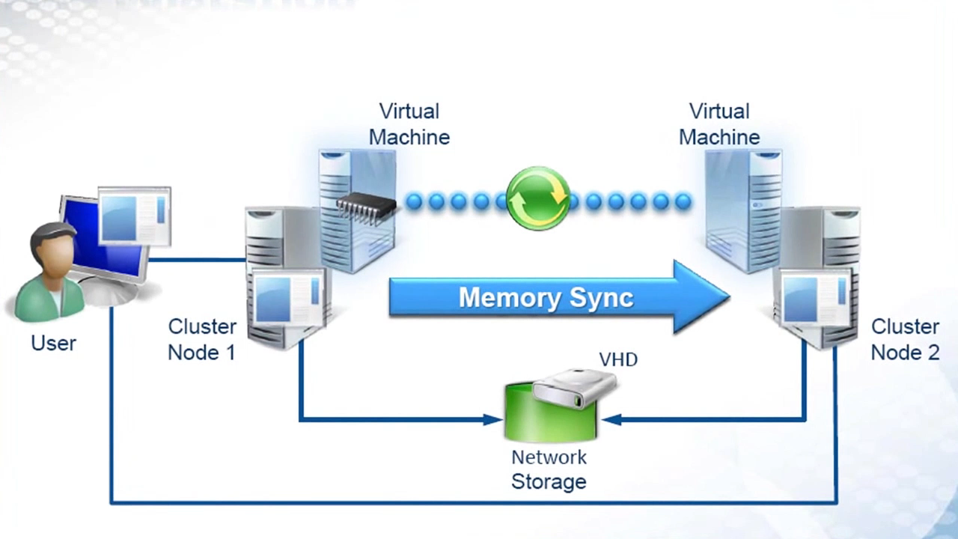
What is VM live migration?

Slide 9
Two VM live migration optimizations
Bandwidth
Optimization
Power consumption optimization

Slide 10

Bandwidth optimization
XBRLE

Slide 11
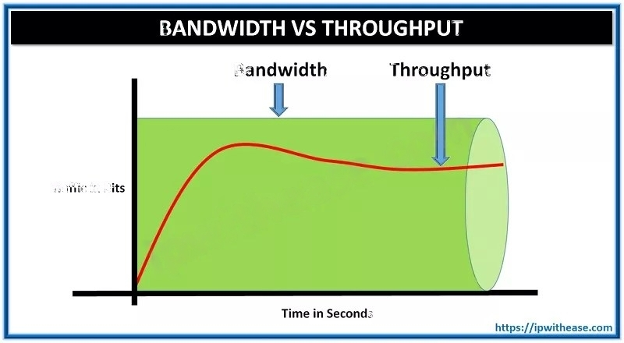
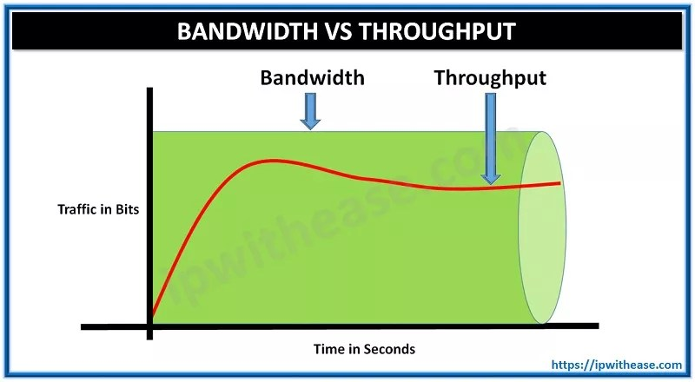
Bandwidth
Bandwidth (רוחב פס) – Maximum amount of data per unit of time

Slide 12
PRE-COPY in high level
Source host
Destination host
Page #1
Page #1
Page #2
Page #2
Page #N
Page #N
Notes:
Suppose our VM consists of N memory pages. We want them to be transferred from source to dest. We start by sending the first one.

Slide 13
PRE-COPY in high level
Source host
Destination host
Page #1
Page #1
State: Page #1 is updated
Page #2
Page #2
Page #N
Page #N
Notes:
Then continue sending the pages one by one.

Slide 14
PRE-COPY in high level
Source host
Destination host
Page #1
Page #1
State: Pages #1-#2 are updated
Page #2
Page #2
Page #N
Page #N

Slide 15
PRE-COPY in high level
Source host
Destination host
Page #1
Page #1
State: Pages #1-#k are updated
Page #2
Page #2
Page #N
Page #N
Notes:
#1-#k are updated

Slide 16
PRE-COPY in high level
Source host
Destination host
Page #1
Page #1
State: Pages #1, #3-#k are updated
Page #2 (dirty)
Page #2
Page #N
Page #N
Notes:
Page #2 got dirty and should be retransferred.

Slide 17
PRE-COPY keynotes
Pre-copy is iterative.
Hot pages should be re-sent more often.
Handover is done when the dirty subset is small enough.
Handover process:
Stop the VM at the source host.
Final copy of remaining data and state.
Start the VM at the destination host.
Notes:
Since dirtying can happen many times, pre-copy is iterative. In the first iteration we transfer all the pages. In each consecutive iteration, we transfer the pages which got dirty during the previous iteration. We stop the VM when the dirty subset is small enough, transfer all data, and start the VM at the destionation.

Slide 18
PRE-COPY Conclusion
We want to reduce migration related network use. Why?
Success depends on both receiving rate and dirtying rate.
Less data re-sent – better success rates.

Slide 19
XBRLE - Overview
Presented in Evaluation of Delta Compression Techniques for Efficient Live Migration of Large Virtual Machines (Svärd et al.)
Optimization for pre-copy live migrations
PROs:
Reduces bandwidth requirements.
Makes the live migration process shorter.
CON:
Requires additional memory.

Slide 20
xbRLE – compression
Data compression minimizes data size.
Compression must work for general purpose data.
Compression must be quick.

Slide 21
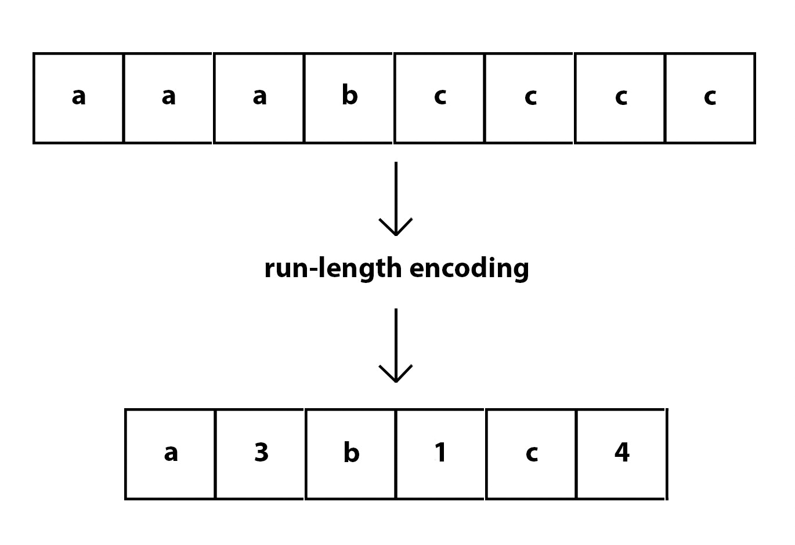
xbRLE – RLE
Solution: Compress data using RLE
PROs:
General purpose
Fast
Easy to implement
CON:
Potentially make the data size larger

Slide 22
XBRLE – Important insight
Only a small part of the dirty page is different.
We can use this insight - any idea?
Sent data
Current data
79 6F 75 74 75 2E 62 65 2F 64 51 77 34 77 39 57 67 58 63 51…
79 6F 75 74 75 2E 62 65 2F 41 41 39 44 36 38 54 4B 2D 78 45 …

Slide 23
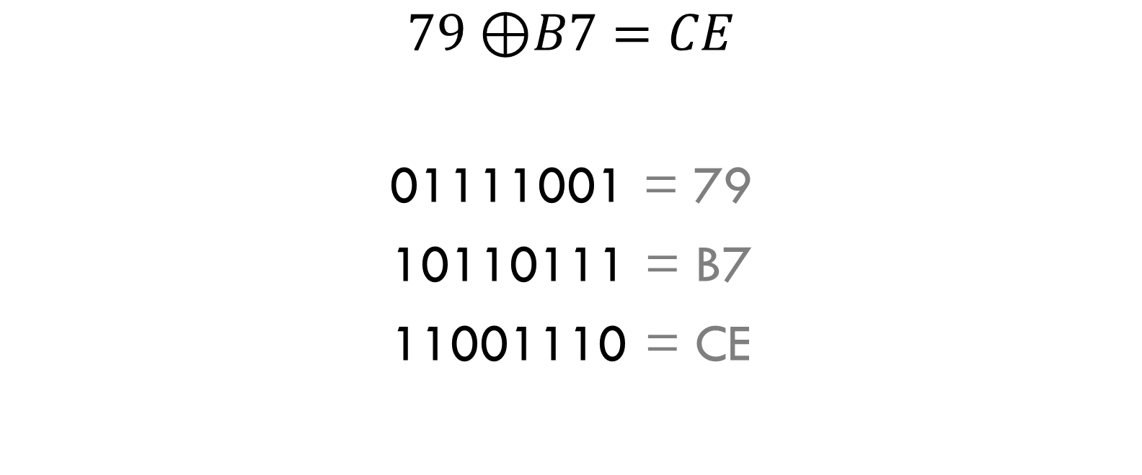
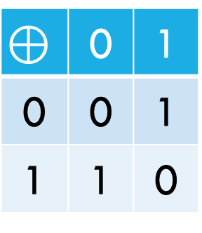

XBRLE – bitwise xor
$$\text{⊕}$$ | 0 | 1
0 | 0 | 1
1 | 1 | 0
Hexadecimal
$$79 \text{⊕}B7=CE$$
01111001 = 79
10110111 = B7
11001110 = CE
$$\text{⊕}$$
Binary
Notes:
In bitwise XOR, we xor the i-th bit of the first operand with the i-th bit of the second operand to get the i-th bit of the result.

Slide 24
XBRLE – XOR binary
Previous
Current
79 6F 75 74 75 2E 62 65 2F 64 51 77 34 77 39 57 67 58 63 51…
79 6F 75 74 75 2E 62 65 2F 41 41 39 44 36 38 54 4B 2D 78 45 …
00 00 00 00 00 00 00 00 00 25 10 4E 70 41 01 03 2C 75 1B 14 00 00 00 00 00 00 00 …
Notes:
We bitwise-XOR the previous version of the page with the current

Slide 25
XBRLE – XOR binary (and rle)
00 00 00 00 00 00 00 00 00 25 10 4E 70 41 01 03 2C 75 1B 14 00 00 00 00 00 00 00 …
Size: 4096 bytes = 4KB
RLE
Byte based
Run
Length
00 0009
25 0001
10 0001
4E 0001
70 0001
41 0001
01 0001
03 0001
Size: 39 bytes
2C 0001
75 0001
1B 0001
14 0001
00 0FEC

Slide 26
XBRLE – XOR binary (and rle)
00 00 00 00 00 00 00 00 00 25 10 4E 70 41 01 03 2C 75 1B 14 00 00 00 00 00 00 00 …
Size: 4096 bytes = 4KB
RLE
Word based (word = 4 bytes)
Run
Count
00000000 0002
0025104E 0001
70410103 0001
Size: 30 bytes
2C751B14 0001
00000000 03FB

Slide 27
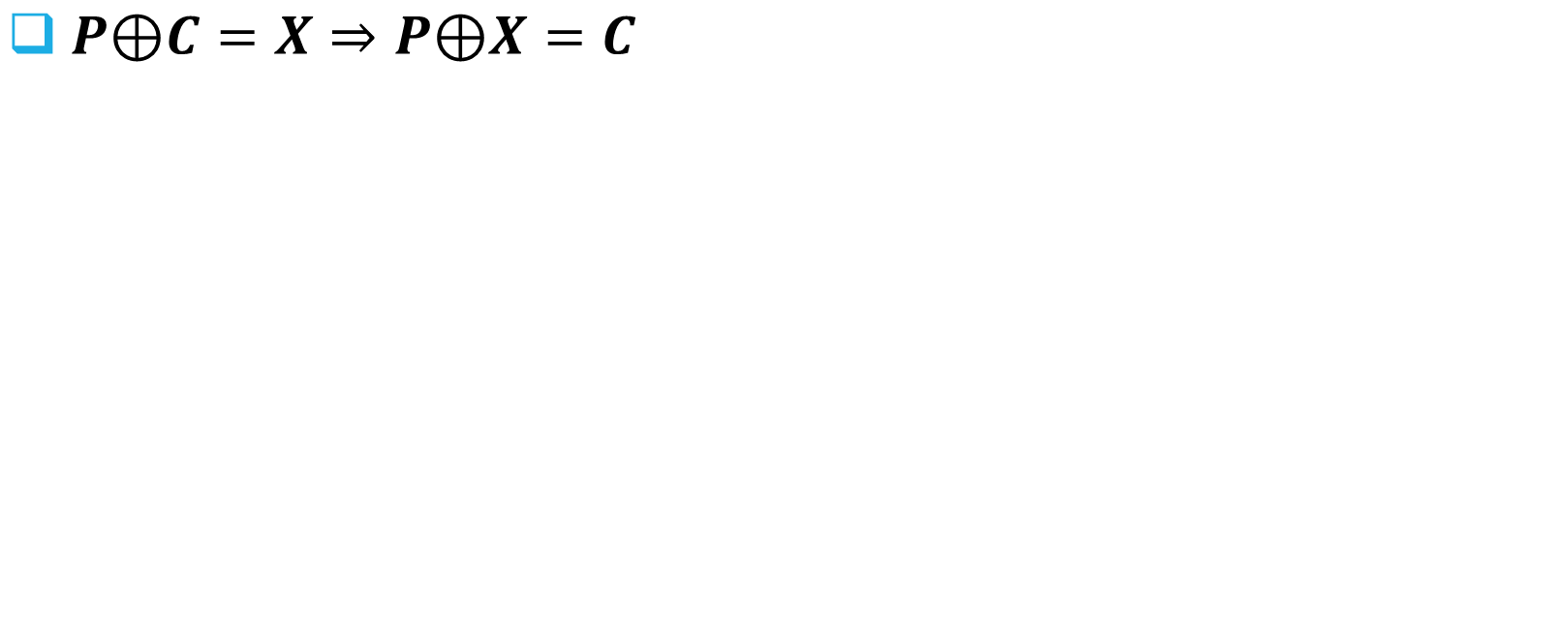
XBRLE – Receiver side
Previous version
$P\text{⊕}C=X⇒P\text{⊕}X=C$
79 6F 75 74 75 2E 62 65 2F 64 51 77 34 77 39 57 67 58 63 51…
XBRLE message
XORed message
Current version
00000000 0002
00 00 00 00 00 00 00 00 00 25 10 4E 70 41 01 03 2C 75 1B 14 00 00 00 00 00 00 00 …
79 6F 75 74 75 2E 62 65 2F 41 41 39 44 36 38 54 4B 2D 78 45 …
0025104E 0001
RLE Decode
70410103 0001
2C751B14 0001
00000000 03FB

Slide 28
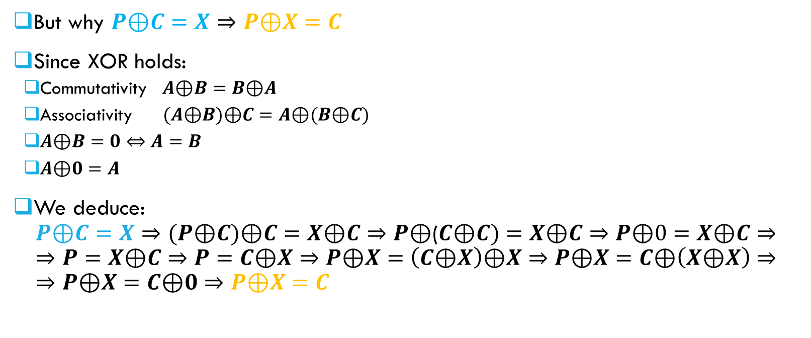
XBRLE – Receiver side
But why $P\text{⊕}C=X⇒P\text{⊕}X=C$
Since XOR holds:
Commutativity $A\text{⊕}B=B\text{⊕}A$
Associativity $(A\text{⊕}B\text{)}\text{⊕}C=A\text{⊕}(B\text{⊕}C)$
$A\text{⊕}B=0⇔A=B$
$A\text{⊕}0=A$
We deduce: $P\text{⊕}C=X⇒(P\text{⊕}C)\text{⊕}C=X\text{⊕}C⇒P\text{⊕}\text{(}C\text{⊕}C)=X\text{⊕}C⇒P\text{⊕}0=X\text{⊕}C⇒$ $⇒P=X\text{⊕}C⇒P=C\text{⊕}X⇒P\text{⊕}X=\left(C\text{⊕}X\right)\text{⊕}X⇒P\text{⊕}X=C\text{⊕}\left(X\text{⊕}X\right)⇒$ $⇒P\text{⊕}X=C\text{⊕}0⇒P\text{⊕}X=C$
Notes:
Formal proof

Slide 29
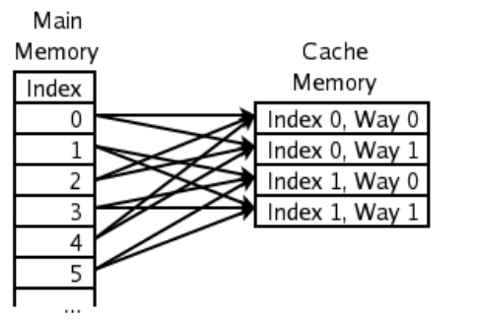
XBRLE – Memory ISSUE
Requires additional memory. Why?
To keep previous version of pages.
Chosen solution – 2-way set associative cache

Slide 30
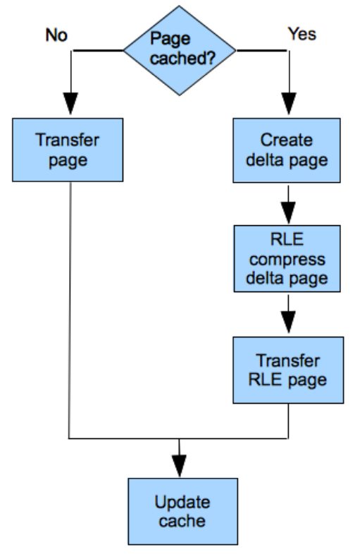
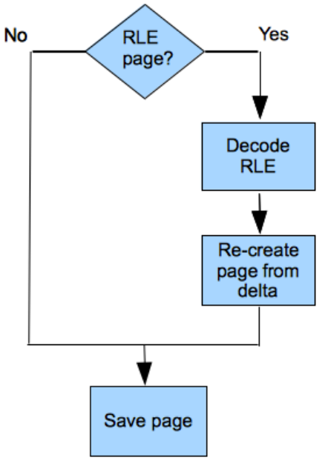
XBRLE – FULL flow
Source
Destination
Notes:
Delta means difference between previous and current version

Slide 31
XBRLE – Results
Three scenarios:
LMbench – standard benchmark
VLC (HD video transcoding server) – high dirtying rate
SAP CI ERP (enterprise resource planning) – resource-intensive and sensitive network timeouts

Slide 32
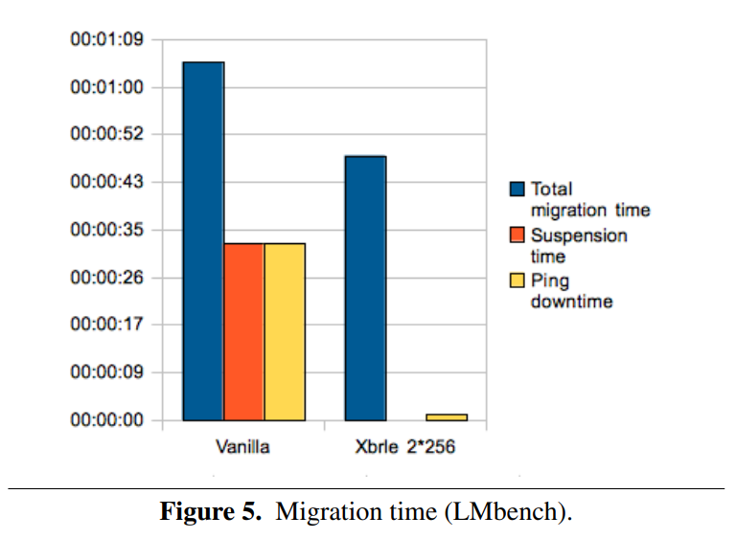
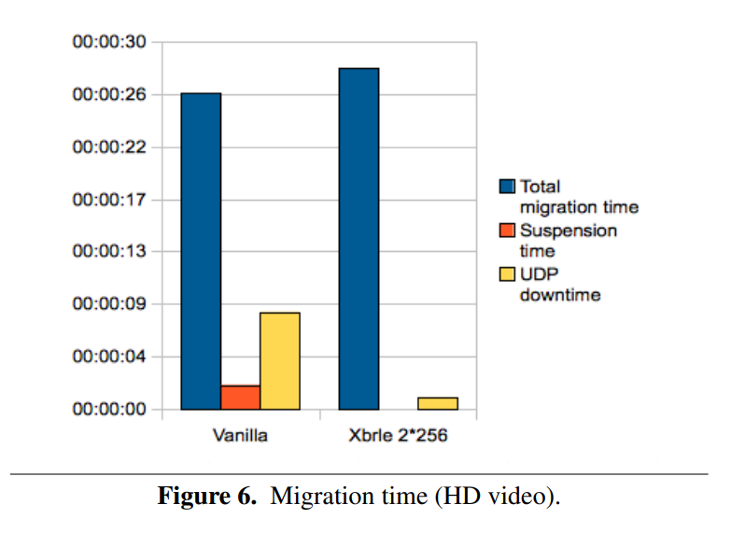
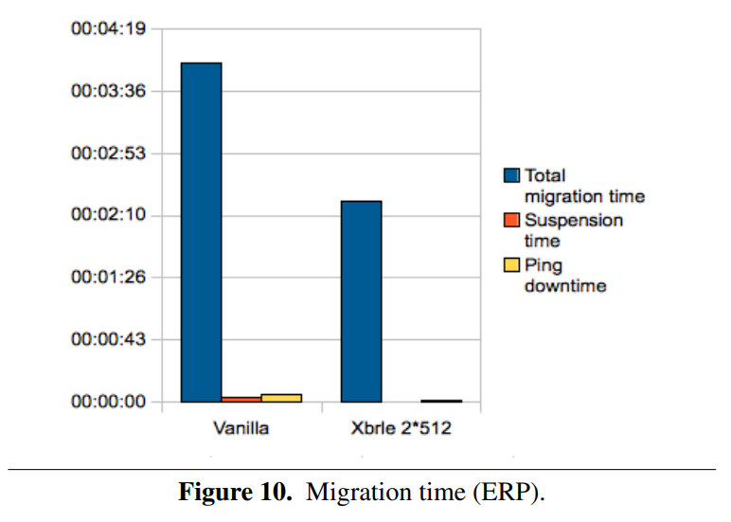
XBRLE – Results (time)
Notes:
Vanilla = without any modification, sending pages as they are (uncompressed).

Slide 33
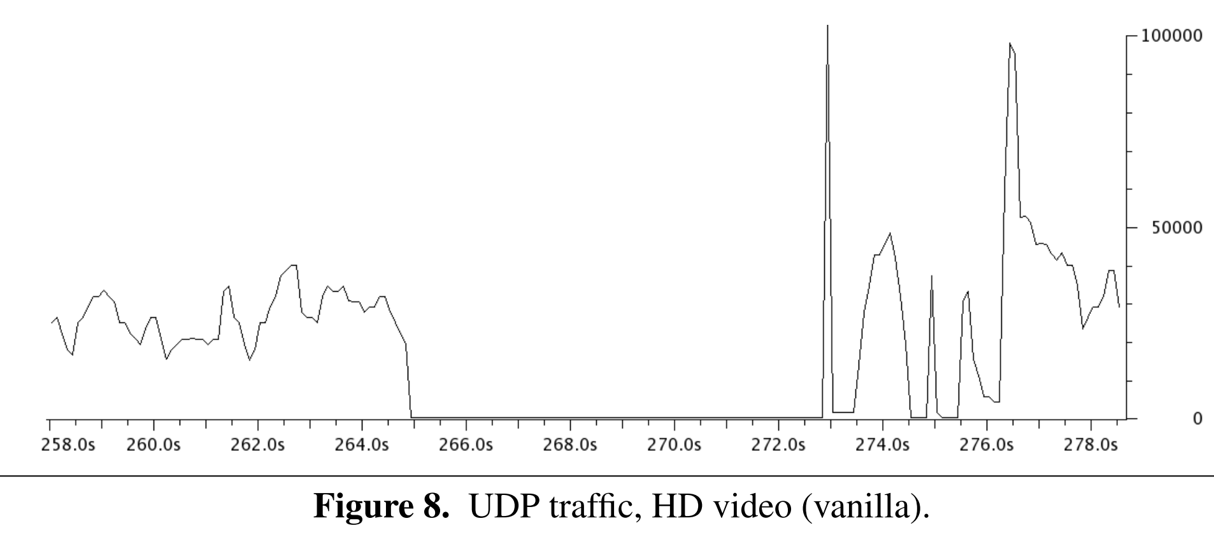
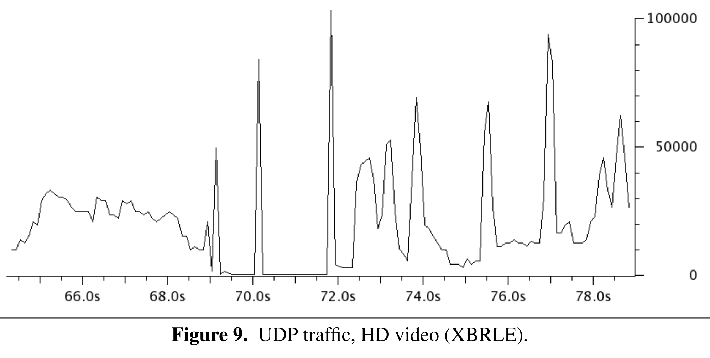
XBRLE – Results (UDP DOWNTIME)
~7.5sec
Notes:
Downtime significantly reduced by XBRLE.

Slide 34
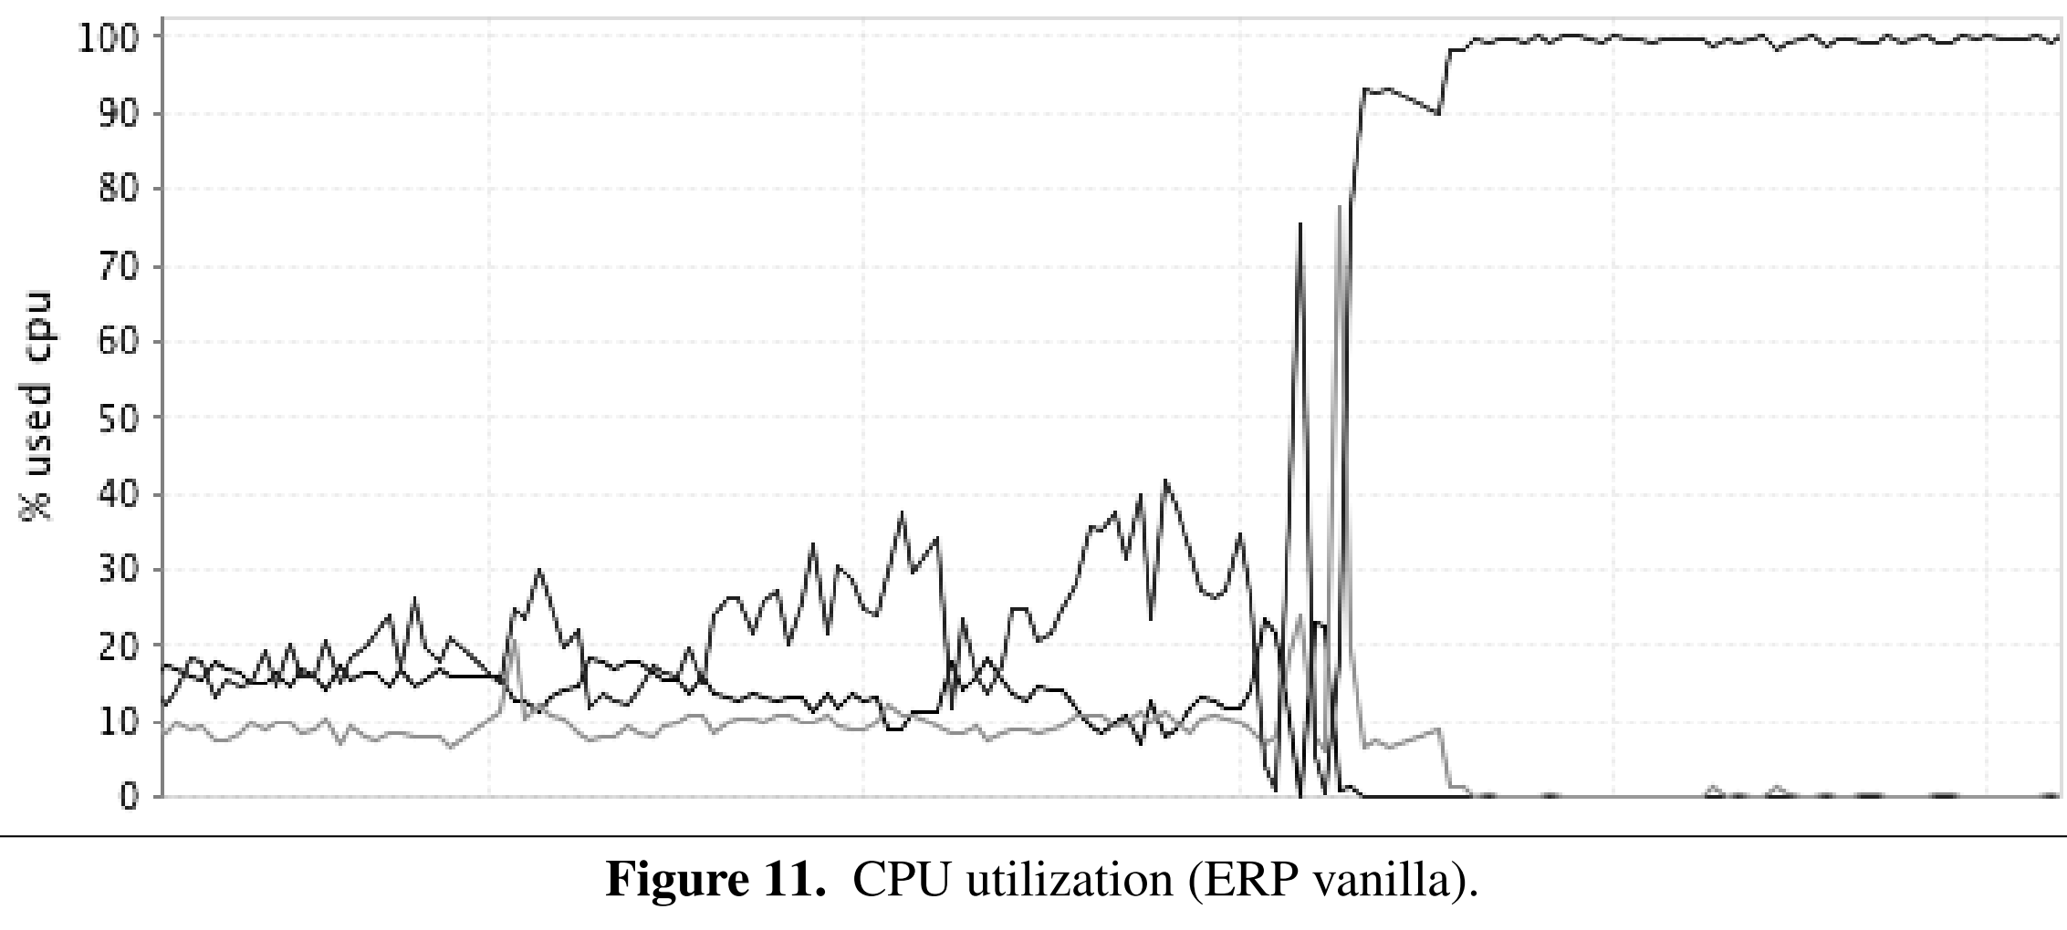
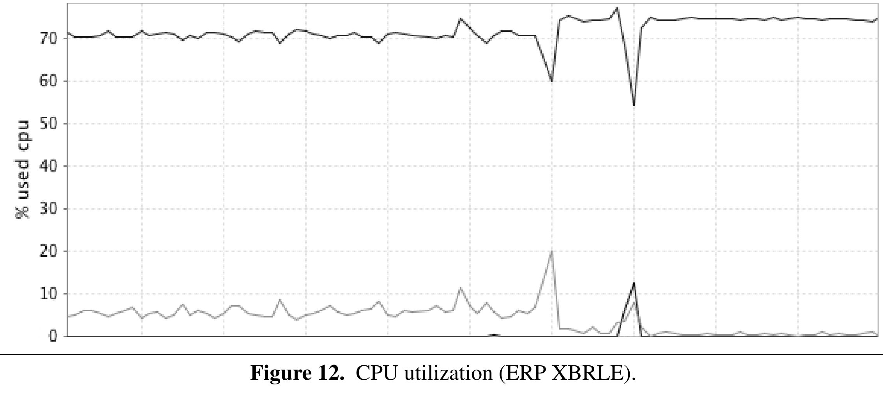
XBRLE – Results (ERP CPU)
FAILED!
■ %CPU used by SAP CI ERP (Software)
■ %CPU used by KVM (Hypervisor)
Notes:
Hypervisor = virtual machine manager
Vanilla migration failed and ERP became unstable due to network starvation. XBRLE migration succeeded even though ERP was dealing with heavier workload. Two significant spikes can be seen because of CPU-intensive iteration (compression part).

Slide 35

XBRLE – FUTURE WORK
Modify cache size dynamically.
Re-order sending order – hottest page last.
Notes:
Photo created by DALL-E 2. Prompt: 3d render of virtual machine

Slide 36
XBRLE – IN real life
Implemented by QEMU (virtualizer & emulator).
Modified version: XBZRLE (stands for zero).
Only runs of zeros are compressed.

Slide 37


DVFS enable-power power capping
Power consumption optimization

Slide 38
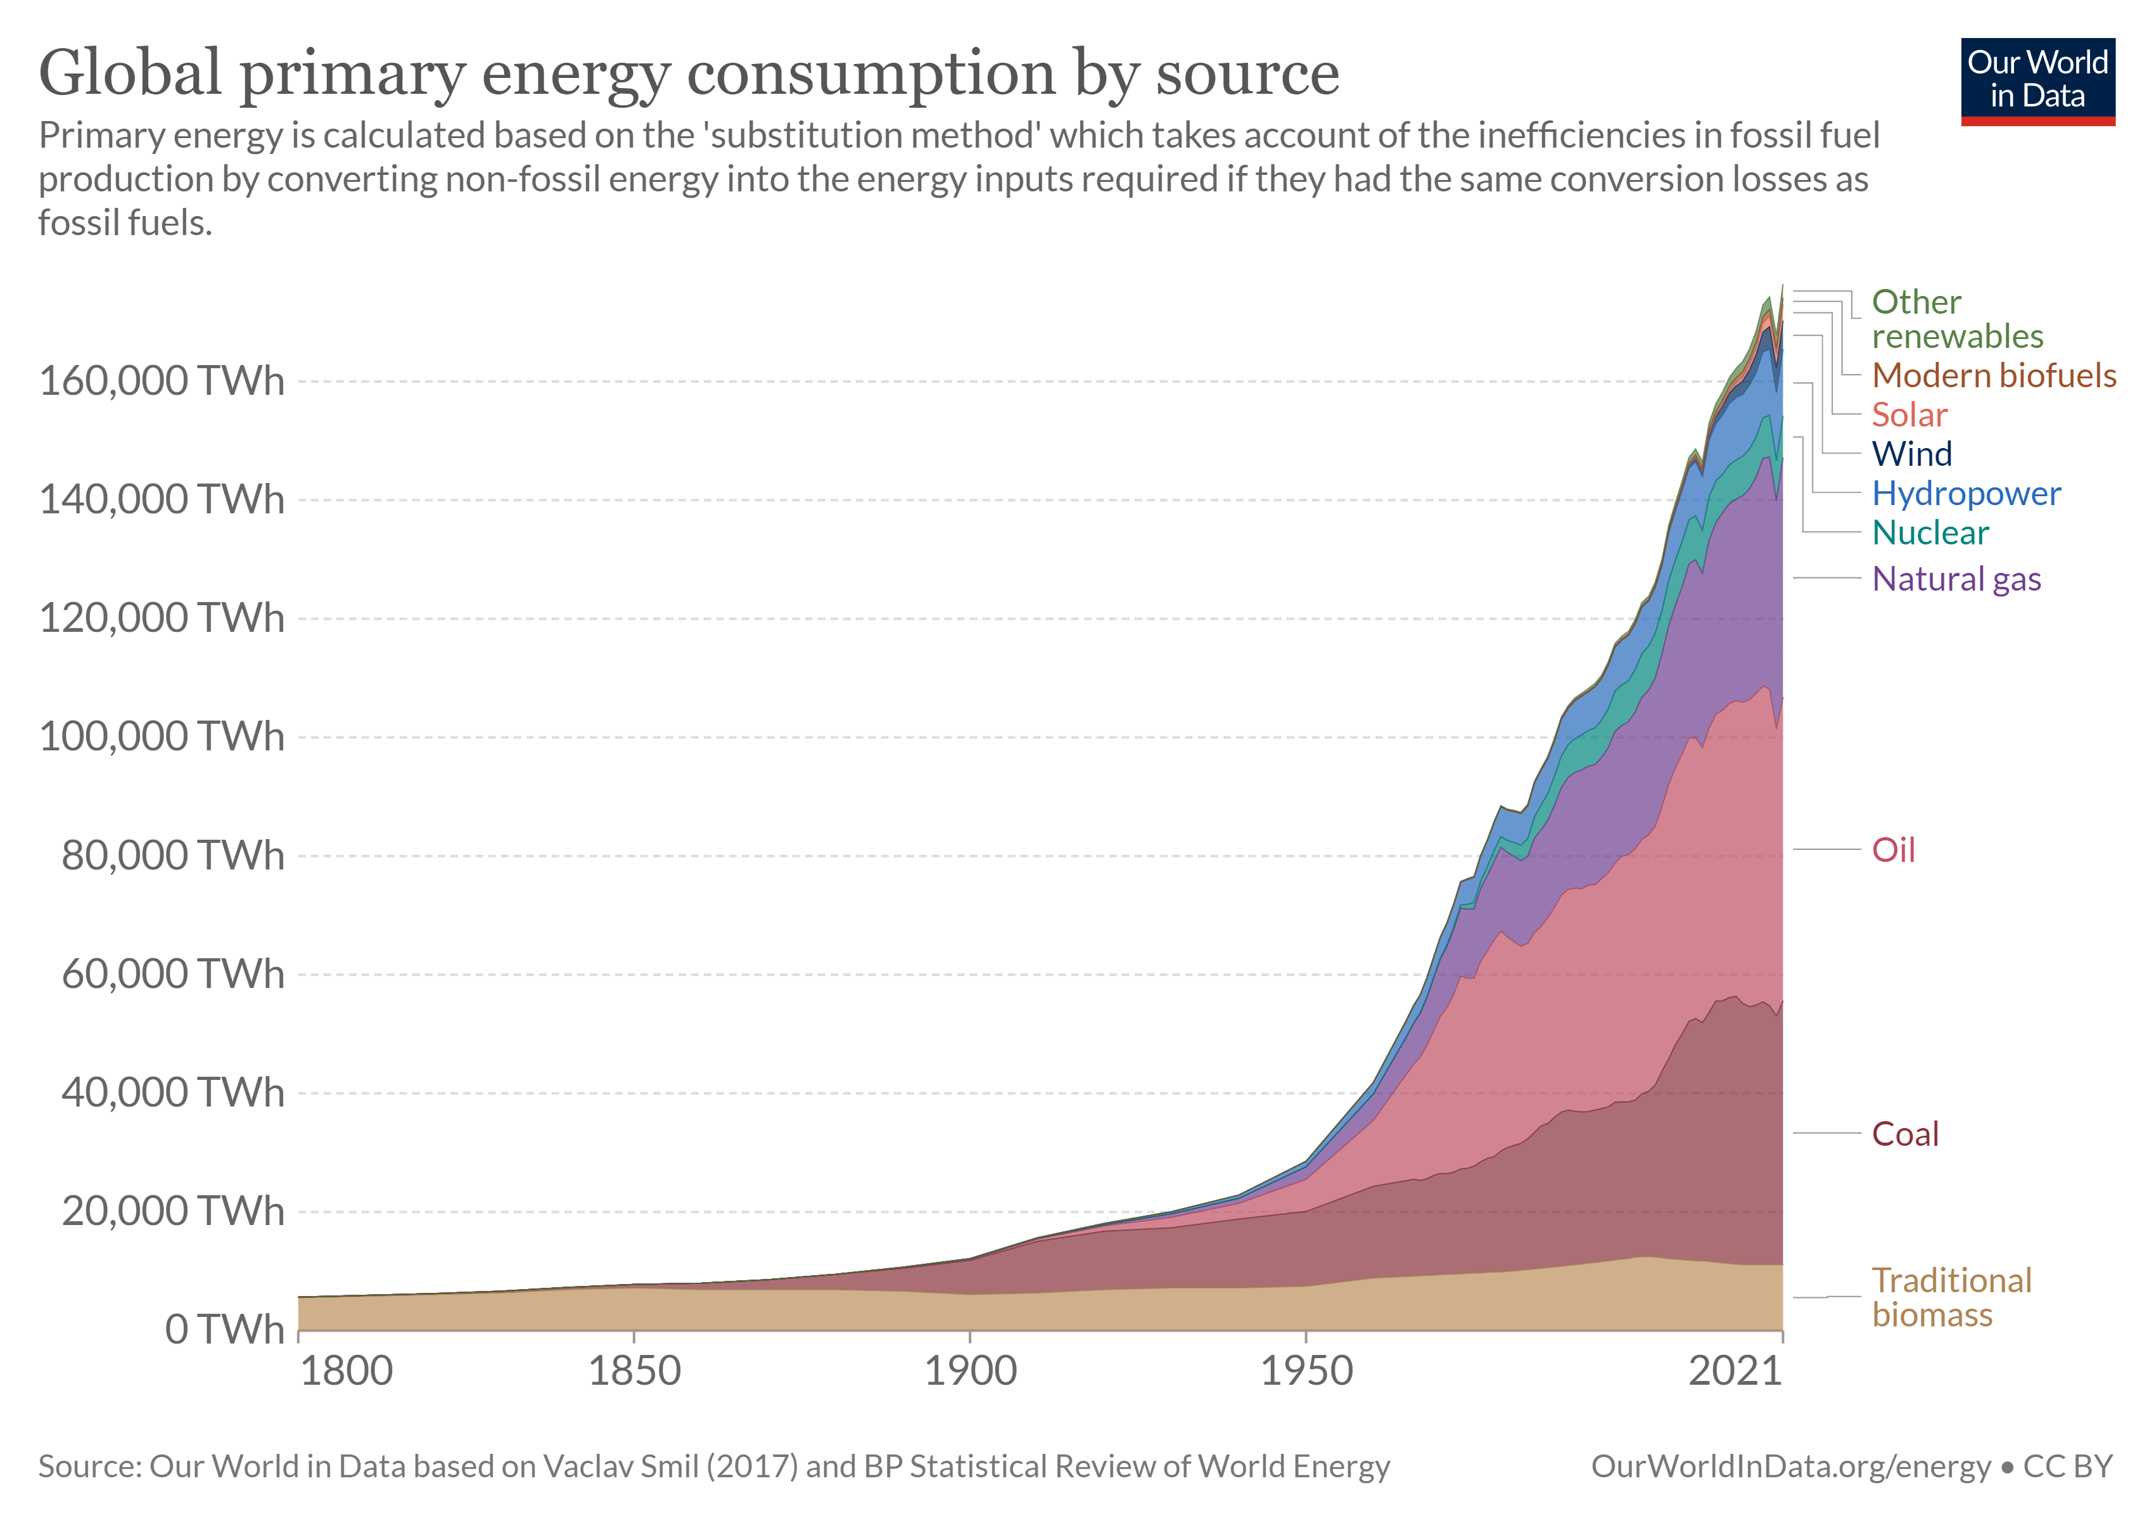
Main problem – power consumption
Power consumption is not negligible.
On an average 30% of DCs exploit only 10-15% of resource capacity.
Limited use of resources results in high DC operational cost and energy usage.
For example: Google DCs are estimated to have consumed 260 million Watts of energy (0.01% of the world’s energy) in 2013

Slide 39
How is live migration related to the power consumption of Data centers?
The more VMs running on a server, the more power it consumes.
Theoretically, migrating VM from a server should decrease its power consumption.
BUT
There is a significant increase in power consumption during live migration.

Slide 40
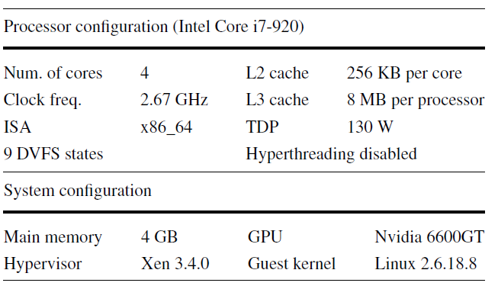
Power consumption during live migration
Experimental system:
Xen hypervisor for the x86 architecture.
Processor with 4 cores, VM on each core, benchmark on every VM.
Source and destination server.
domain 0 handles most of the migration activities.
Focus on twolf & gap benchmark migration.
Notes:
A benchmark workload refers to a collection of programs used for a particular evaluation. The term workload benchmark testing refers to evaluating a collection of programs. The goal of benchmarking is to compare systems or programs against eitcher other.
domain 0 handles most of the migration activities such as initiating migration procedures, managing required data structures and transferring memory contents.

Slide 41
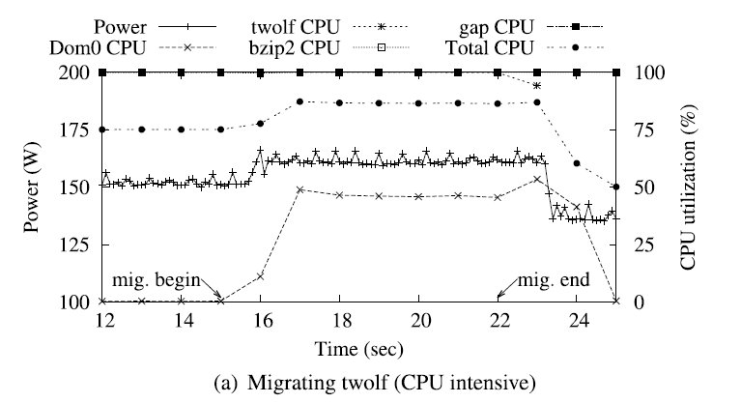
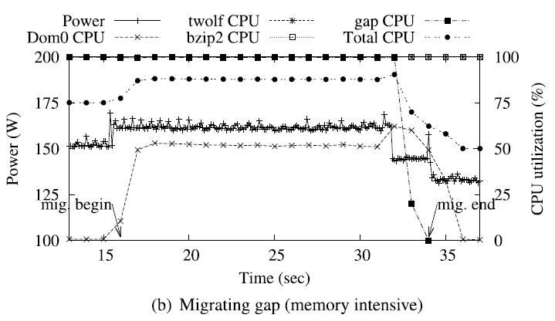
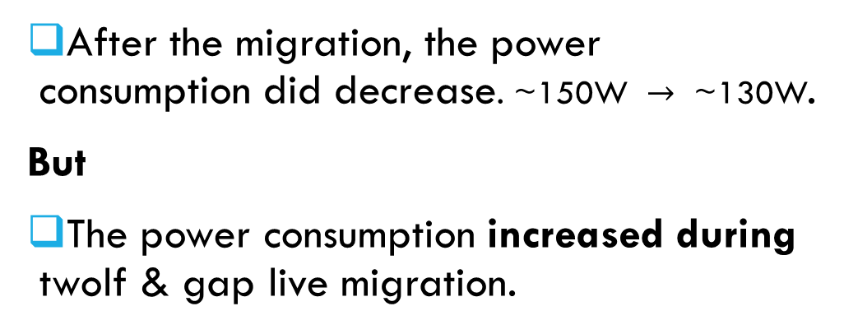
Twolf VS gap migration
 | Twolf | gap
Memory intensive | The least | The most (write)
Memory footprint | ~3.5MB | ~200MB
Time to complete | ~8s | ~20s
After the migration, the power consumption did decrease. $\text{\sim }\text{150}\text{W} →\text{ \sim }\text{130}\text{W}$.
But
The power consumption increased during twolf & gap live migration.

Slide 42
What can we do?
We want an instant reduction in power consumption while meeting SLA terms & minimal impact on QoS.
DVFS enable-power
Power Capping

Slide 43
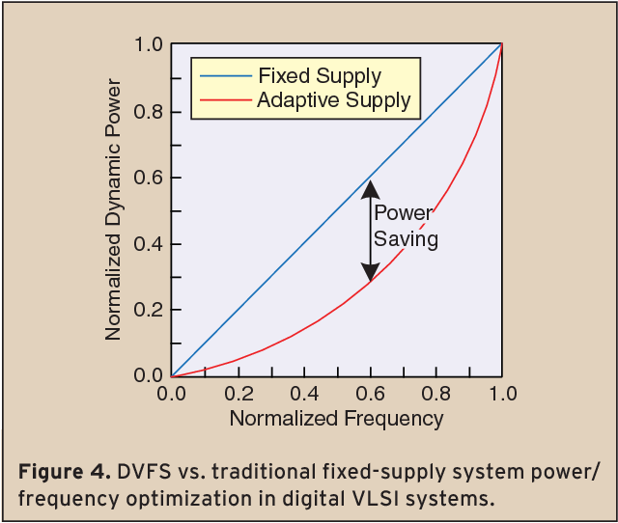
#1: DVFS-enabled power optimization
DVFS – Dynamic Voltage Frequency Scaling.
A Hardware improvement in the CPU.
The method: change the frequency and voltage to adjust the CPU’s clock rate.
The result: CPU does less work, therefore consumes less power.
We can use DVFS and lower the CPU’s clock rate during a live migration to gain an immediate decrease in its power consumption.
(How dynamic voltage and frequency scaling affects power consumption.)
Notes:
The method: change the frequency and voltage to adjust the CPU’s clock rate, in order to enhance energy efficiency within DC.

Slide 44
#2: Power Capping
Under the VMs scheduler a CAP value is given to each VM.
CAP value defines the maximum CPU time given to the VM in a certain time interval.
Default CAP value is 0, meaning no limitation.
Before launching migration, set the CAP value.
A non-zero CAP value limits the CPU usage the VM can normally receive during live migration. As a result, the CPU does less than 100% of its capabilities. Therefore, the CPU consumes less power.

Slide 45
vs
DVFS enable-power
Power Capping

Slide 46
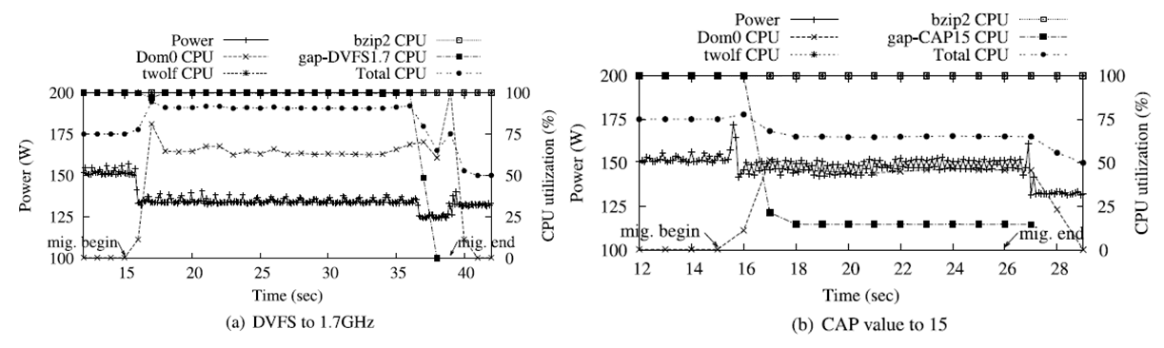
DVFS performance
Clock rate set to 1.7 GHz.
Total power consumption of the server decreases significantly to 135.6 Watts.
A 10% decrease in energy consumption.
Notes:
חשוב להדגיש כי ה100% ניצול של המעבד לפני הנדידה אינו אותו ה100% תוך כדי הנדידה כי היכולת של המעבד ירדה ברגע שהורדנו את קצב השעון

Slide 47
Cap value performance
CAP value set to 15 for migrated VM.
Total power consumption of the server decreases a bit to 148.3 Watts.
A 3% decrease in energy consumption.

Slide 48
DVFS vs power capping
DVFS is better at reducing power consumption compared to power capping.
The higher the CPU utilization, the more energy the DVFS approach saves.
BUT
DVFS affects the performance of the other VMs on the server.
Only processors that hardware support DVFS can use it.
Therefore, it is better to use power capping if the energy consumption it provides is acceptable.
Notes:
Remember our main goal is to decrease power consumption during live migration, meet SLA, and don’t harm QOS
Con for DVFS: bad for QoS, requires CPUs support which is limited.

Slide 49
Conclusion & Future works
DVFS & Power Capping are simple and straightforward approaches that successfully suppressed the power consumption increase during live-migration.
These methods cannot accurately control or predict the power consumption changes and performance impact due to live-migration instances.
Furthermore, the current power-capping schemes are incomplete
In terms of controlled power consumption suppression.
Therefore, server power-capping is drawing enormous attention from both academia and industry.

Slide 50
conclusion
two Live migration optimizations
Bandwidth
Optimization
Power consumption optimization
XBLRE
DVFS & Power capping

Slide 51
Thank you!

Slide 52
references
A survey on virtual machine migration and server consolidation frameworks for cloud data centers
Evaluation of Delta Compression Techniques for Efficient Live Migration of Large Virtual Machines (Svärd et al.)
Analysis of virtual machine live-migration as a method for power-capping | SpringerLink

